Slide 1


One Bone
Winston Heraldo
Shivam Sood
Kristian Campbell
Jolly Rogers
Aldrin Fernandez
Alessio Iannella
Sargis Nahapetyan

Slide 2








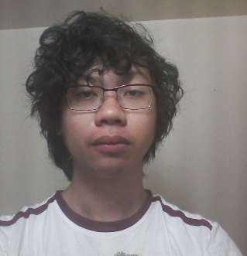
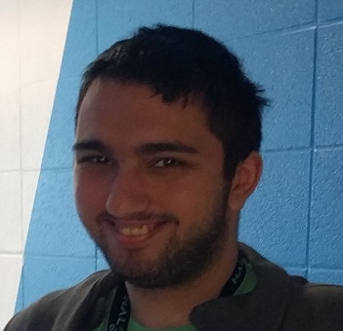
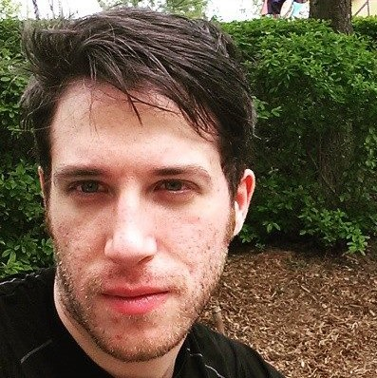
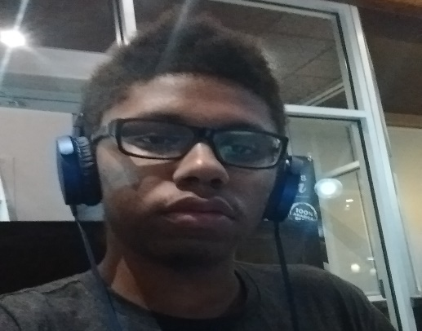
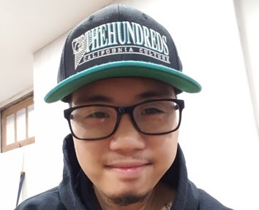

Roles
Software Engineer(s)
Project Manager
Artist
Game Designer
QA Tester
Aldrin Fernandez
Sargis Nahapetyan
Alessio Iannella
Kristian Campbell
Winston Heraldo
Shivam Sood
Manages GitHub repository
Responsible for adding in game features
Responsible for scripting and scene creation, works with the game designer
Maintains a logical coding standard
Oversees the entire project
Makes sure deadlines are met
Responsible for all documentation
Responsible for all art, sound and multimedia creation
Creation of original assets for the game
Minimizing all asset file sizes
Responsible for defining game mechanics
Makes sure all other roles are on track
Plans the layout of levels and game events
Tests all features of the game
Ensures the game is bug free
Creates feedback documentation

Slide 3


Overview
Original Game Overview
Game Idea
We first ran through a bunch of themes for the game, such as Space and Medieval. Each group member said one theme, we then did a vote. The majority voted for a pirate game. We did a bunch of other votes discussing the characters, story, and playstyle.
One Bones is a 2D platform game that follows Captain Bonnie Brinks and her crew in lifting their “skeleton curse.”
The game will bring the player into a pirate world where they will have to defeat enemies and overcome many obstacles in order to release them from the curse.
The majority of group members also had a liking to One Piece

Slide 4
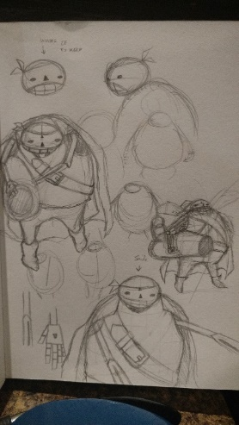
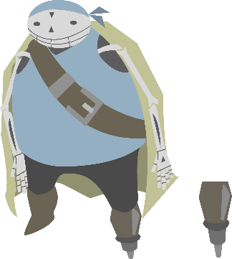
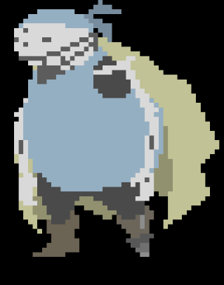


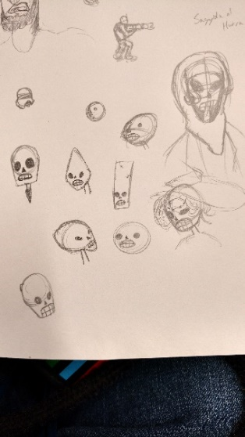
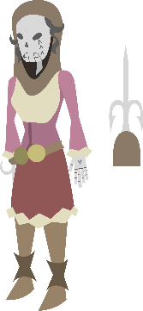
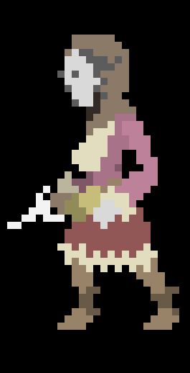

Planning
Original Work Guidelines
How we keep on track
We will hand in assignments a day early
We will complete 55% of the work between the start and end of the due date
We will regularly keep track on one another
We will finish other assignments before starting our current one
We will finish our current assignment before starting others
We will divide the work appropriately
We will plunder your loot
Final Logo

Slide 5






Instruction
Captain Bonnie Brinks
Bobby Bazooka
Goal
Is a short-ranged fighter. She uses a sword to attack.
Is a long-ranged fighter. He specializes in projectile weapon.
Pickups
Reach the end of each level whilst defeating the boss at the end.
Eat fruits to replenish your health from damage taken.
Enemies
Avoid enemies as they will take away your health and eventfully kill you.
Move Left
Move Right
Jump
Attack
Switch Characters

Slide 6

Demonstrate
Click This

Slide 7
Lessons Learned
Challenges
Ontario Collage strike
Shortened school term (-1 week)
Conflicted Courses
Managing other class work
What we would have done differently
Keep in touch with local news
Re-due our timetables (for the strike)
Fully plan our weeks
Ask for help when we needed it
Manage out time a bit better

Slide 8

Future Possibilities
Additionally
We would use the extra time to fully develop our game. By adding more levels, characters, cut scenes and much more. We would also fully develop the story and improve the game play mechanics.
Needs (Need to do) | Wants (Want to do)
Two playable characters | Co-op
Travel actions | More levels
Upgrade system | More characters
Grappling hook | Additional upgradable weapons
Sword combat | Bosses
Gun combat | Online Co-op.

Slide 9
The End
Yea, were done

